Slide 1

Spreadsheets and Charts EPB January, 2020
Rebecca Olson, Business and Social Science Informationist
Rebecca.olson@uc.edu or ASKDATA@uc.edu
Research & Data Services, UC Libraries
Notes:
Introduction –
I am an Informationist with RDS, where we help researchers, faculty, staff, and students with their data needs.
This workshop is one in a series covering using, cleaning, and storing data.

Slide 2
Overview
Covered in this class
Not covered in this class
How to structure, format, and clean your data
How to deal with dates and null values
How to create charts and graphs from your data
How to create a run chart
How to do statistics or advanced formulas
Notes:
Although we will be using Excel in this workshop, the information presented should work for other spreadsheet programs, including Google Sheets. The menu options may be different, but the options to perform these units and the data science behind our advice will work with any spreadsheet tool.
We will not be covering every basic step in Excel. Some familiarity is expected.
We will also not be covering advanced formulas or how to create statistics from your data in this class.
We will be focusing on naming conventions, tips and tricks to make your spreadsheets machine readable.

Slide 3
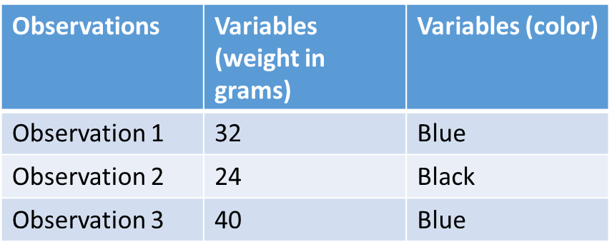
Structure your data
Variables in Columns
Observations in rows – 1 observation per row
1 piece of information per cell
Leave data raw – make a copy to work from (make a new tab)
Export cleaned data to text based format (CSV, Tab)
Notes:
In a typical spreadsheet, Variables are in columns and observations are in rows.
One of the very basic best practices for spreadsheets is to have one observation per row.
Always start by making a copy of your raw data – and work from your copy. Don’t work from your raw data, ever. Mistakes can be hard or impossible to fix

Slide 4


Formatting your data
Formatting is just for looks. It’s program specific, not data specific.
Don’t use it to convey information about the data or to structure the data!
Good Data Management Tip: Name Your Variables Smartly
Use abbreviations that make sense long term.
Avoid special characters
Use the Pothole(Snake Case) Test_Results_1a or Camelback (Camel Case) TestResults1a formats
Good Name | Good Alt | Avoid
Max_temp | MaxTemp | Maximum Temp
Precipitation | Precipitation_mm | precmm
Sex | Sex | M/F
Weight | Weight | w.
First_observation | Observation_01 | 1st Obs.
Notes:
Formatting data when creating a usable spreadsheet.
Don’t use formatting to convey information about or structure the data. Color may look pretty, but color is not machine readable. Bolding may make it easier to read, but it doesn’t affect the analysis tools. You may include asterisks, foot notes, or other notational marks, but these will not be read by the program.
Use good data management sense when naming your variables. Use abbreviations that make sense. Don’t call Joe’s first observation, Joe1, call it JSObserv1 (Joe Smith’s first observation). Make a “Read Me” file explaining what the variable names mean and store it with the spreadsheet.
Use name formats consistently – either the Snake or Camel formats. They eliminate spaces and allow for easier sorting. Pick a naming convention and stick with it for your lab, project, group, etc.
DISCUSS TABLE – ASK FOR INPUT

Slide 5
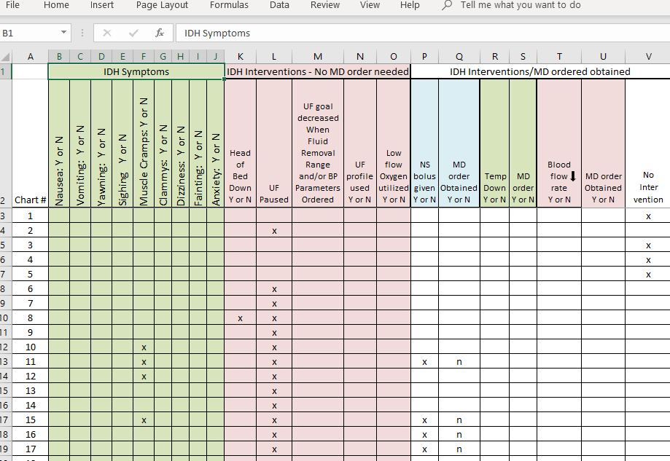
Where should formatting be cleaned up?
Notes:
GROUP ACTIVITY- break into groups and look at this collection of tables. What do you observe?
Answers:
Dwelling:
Roof_type: no spaces for #4, #8, #10
Wall Type: no underscore for variable name
Floor Type: misspellings for earth
Rooms: negative number (may be a NULL), color indicating a barn.
-issue because – not machine readable.
Livestock:
Livestock_owned_and_numbers : multiple variables in one cell
Poultry
Plots:
Plots: some blanks, some negative
Water use: no underscore in title, N and No, Y and Yes, conditional, numbers – a mess

Slide 6

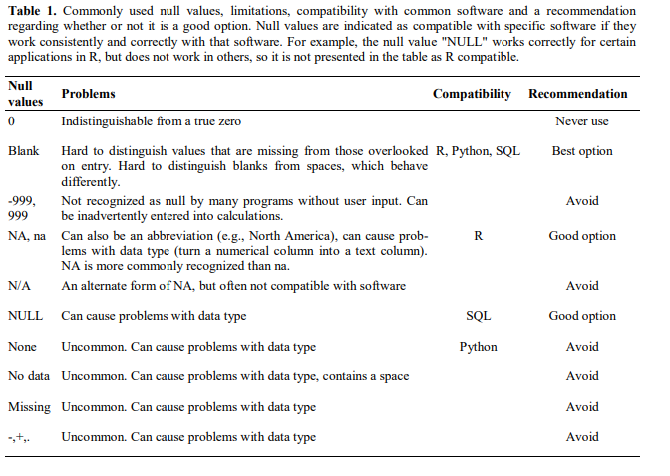
Null/Zero Values
https://ojs.library.queensu.ca/index.php/IEE/article/view/4608
Notes:
What happens if you have no observations for certain variables?
Was it a mistake, or was it on purpose? Was it a Null (no value) or a Zero (actual recorded value)
This is a chart that details guidelines to use for null or zero values.
As you can see, it really depends upon which processing tool you will be using to analyze your data as to which is the best bet. In general, leaving a missing variable as a blank is the best option. Avoid 999/Null, NA, etc, and avoid Zero unless it’s the actual measured value.

Slide 7
Metadata
Metadata
Descriptive
Administrative
Structural
Contextual information about the data, stored with the data
Examples – full description of the fields, full questions and answers
Store it in a txt file with the CSV.
Reproducibility/Clarity
What Metadata Is needed?
Notes:
When creating a spreadsheet (or any form of data collection), you should consider adding relevant metadata to your “read me” file.
This will allow others to understand what the file is (spreadsheet), what the variables are (descriptions of fields and origin of data), and who created it and who has access rights (or storage, disposal, etc).

Slide 8

Dates
Regional variation
Solution? Split dates into separate cells.
Formulas to use to the entire column:
=MONTH()
=DAY()
=YEAR()
Notes:
Dates can come in many formats depending upon who is entering them. Regional variation can pose problems when sorting.
One solution is to split the date fields into separate fields, Month, Day, Year
Show an example of how to do so.
Ask students to pick a date column in the Safi safe data and separate them.

Slide 9

QA for Spreadsheets
Can set parameters for data entry to validate upon entry
Restrict data to format, date/numeric range, list
Data Tab- Data Tools – Data Validation(or Validation Tools)
Allow: Whole number, List, etc.
Notes:
You can set data validation rules for data entry to force responses to be only certain answers on a list, certain formats, or certain ranges.
Demonstrate how to use the validation tools on the handout

Slide 10
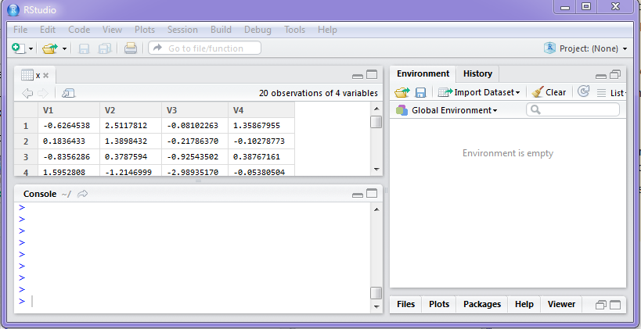
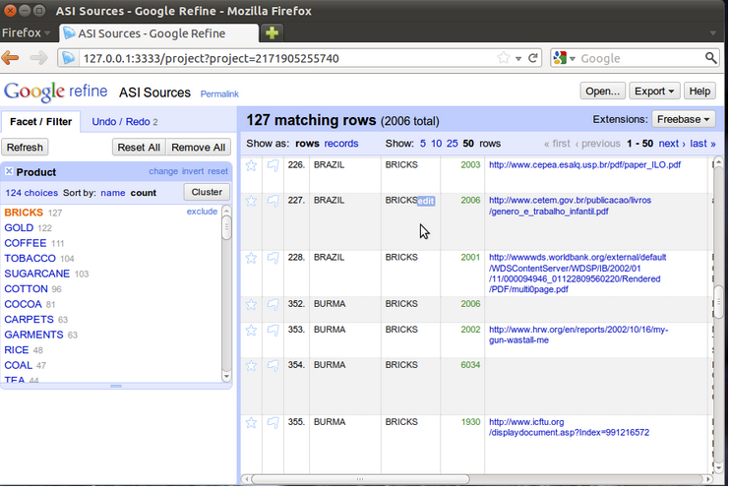


Exporting Data
Excel formatting - .xls, .xlsx
Why change to .csv?
Notes:
You can save your data in Excel or Google Sheets or whichever format you prefer, but make sure to save a copy in .csv as well. This will allow your data to be read in multiple software options and in future years as well. Saving it to .xls may result in it not being read in future versions of the program or may not be read by those who only have access to Google Sheets or another spreadsheet program.
Saving it to .csv also allows you to upload your data into R Studio, to clean it in OpenRefine, and to process it using other tools.

Slide 11
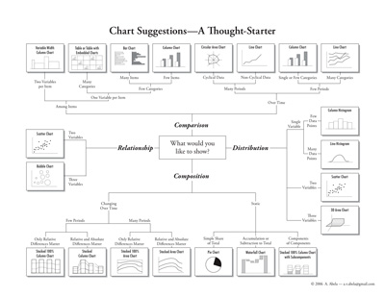
Making Charts
May require data manipulation (Averages, sum, counts, etc)
Must figure out which chart to choose (Intro to Data Visualization class)
https://extremepresentation.typepad.com/files/choosing-a-good-chart-09.pdf

Slide 12
Charts and Run Charts
Open Temp_Chart
Make a copy (and name it)
Insert a chart

Slide 13
Acknowledgment
This presentation was based on the Spreadsheets for Social Sciences workshop from Data Carpentry. https://datacarpentry.org/spreadsheets-socialsci/

Slide 14
Thank you!
ASKDATA@ UC.EDU /Rebecca.Olson@uc.edu
Cleaning Data with Open Refine Workshop, (CECH) Weds Feb 12, 10-12pm
Spreadsheet Best Practices, Mon Jan 27th, 10-12 pm, CEAS and Tuesday, Feb 25, 10-12 pm, Viz Lab
Programming with R Open Lab, (Viz Lab), Tues Feb 4, 2-4 pm
https://webapps2.uc.edu/ce/facdev/Workshops/Index/UCL_P

